Slide 1
NODE.JS
(The Backend Of MERN Stack)
Lecture 42

Slide 2
Today’s Agenda
Introduction To Cookies
Purpose Of Cookies
Using Cookies In Express
Configuring Cookies
Examples
Login App Using Cookies

Slide 3
Introduction to cookies
Almost every website/web app stores a small amount of data on the browsers.
There are two most popular browser-based storage:
local storage
cookie storage
In this lecture we will be discussing about cookie storage.

Slide 4
What are cookies ?
Cookies are small text files which a browser receives from the server embedded inside the response.
These cookies are then saved by the browser in the secondary memory of the device .
Now , the next time when the same browser sends next request to the same server it also transmits these cookies .

Slide 5
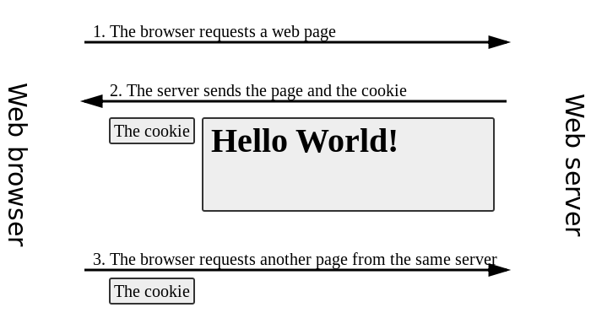
What are cookies ?

Slide 6
Purpose of cookies
Cookies help the website we have visited to know more about us and customize our future experience:
User preferences for ex: sites like youtube use cookies to display a recommended list of videos as per the users previous video views.
Shopping Cart: When we include items into our shopping cart, a cookie will remember our choices. Our shopping list items will still be there whenever we revisit the site.
In short we can say that , a Cookie is used to remember data from the user.

Slide 7
Using cookies in express js
In Express.js, we can set and retrieve the cookies using the cookie-parser middleware.
This middleware parses incoming cookies and populates the req.cookies object with the key-value pairs of all cookies sent by the browser.

Slide 8
Using cookies in express js
To use the cookie-parser middleware, we first need to install it using npm:
npm install cookie-parser
Next, we need to import it in our application and use it as middleware before our routes as shown in next slide

Slide 9
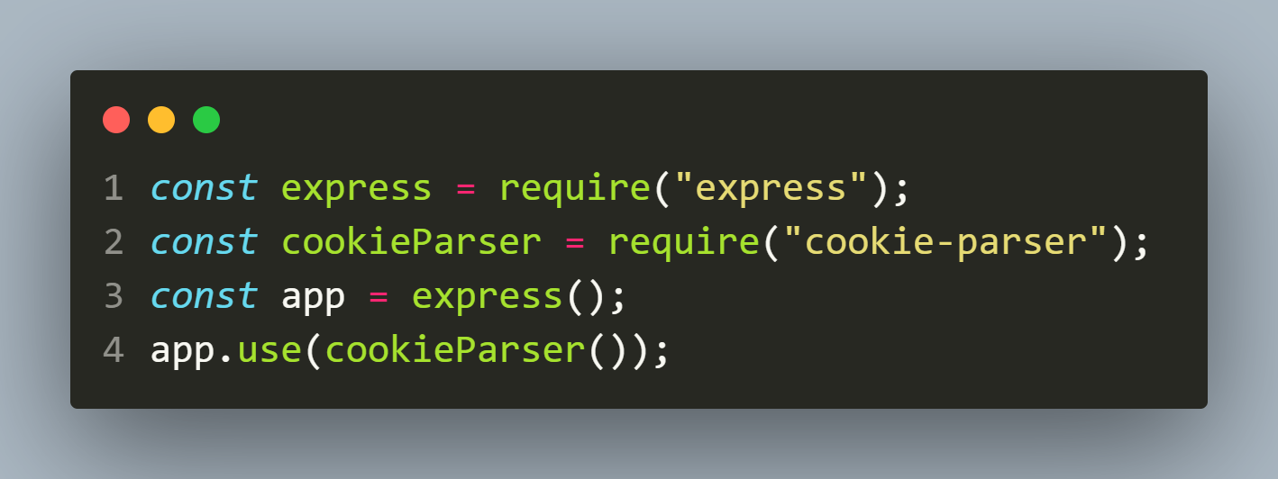
Using cookies in express js

Slide 10
Setting a cookie
To set a cookie to be sent to the browser we call the method cookie() belonging to response object.
Syntax:
resp.cookie(‘<cookiename>’,<cookievalue>,[options]);
Example:
resp.cookie(‘username’,’Sachin’);

Slide 11
reading cookie
We can access the cookies using the cookies property of request object.
It can be done in 2 ways:
req.cookies: Returns an object containing all the cookies sent by the browser. If the request contains no cookies, it defaults to { }.
req.cookies.cookie_name: Returns only the specific cookie.

Slide 12
Exercise 87
Create an Express application for handling 2 routes:
GET / : This route should create and send a cookie called visittime to the browser containing the current date and time when the user visited the site. It should also provide a link to the user to visit the next route.
GET /show : This route should read and display the user’s last visited date and time through the visittime cookie.

Slide 13
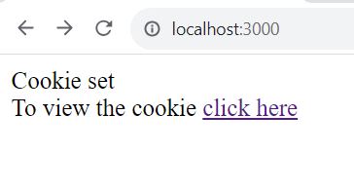
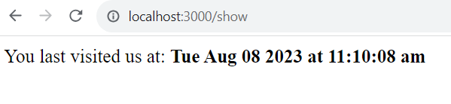
Desired output
http://localhost:3000
http://localhost:3000/show

Slide 14
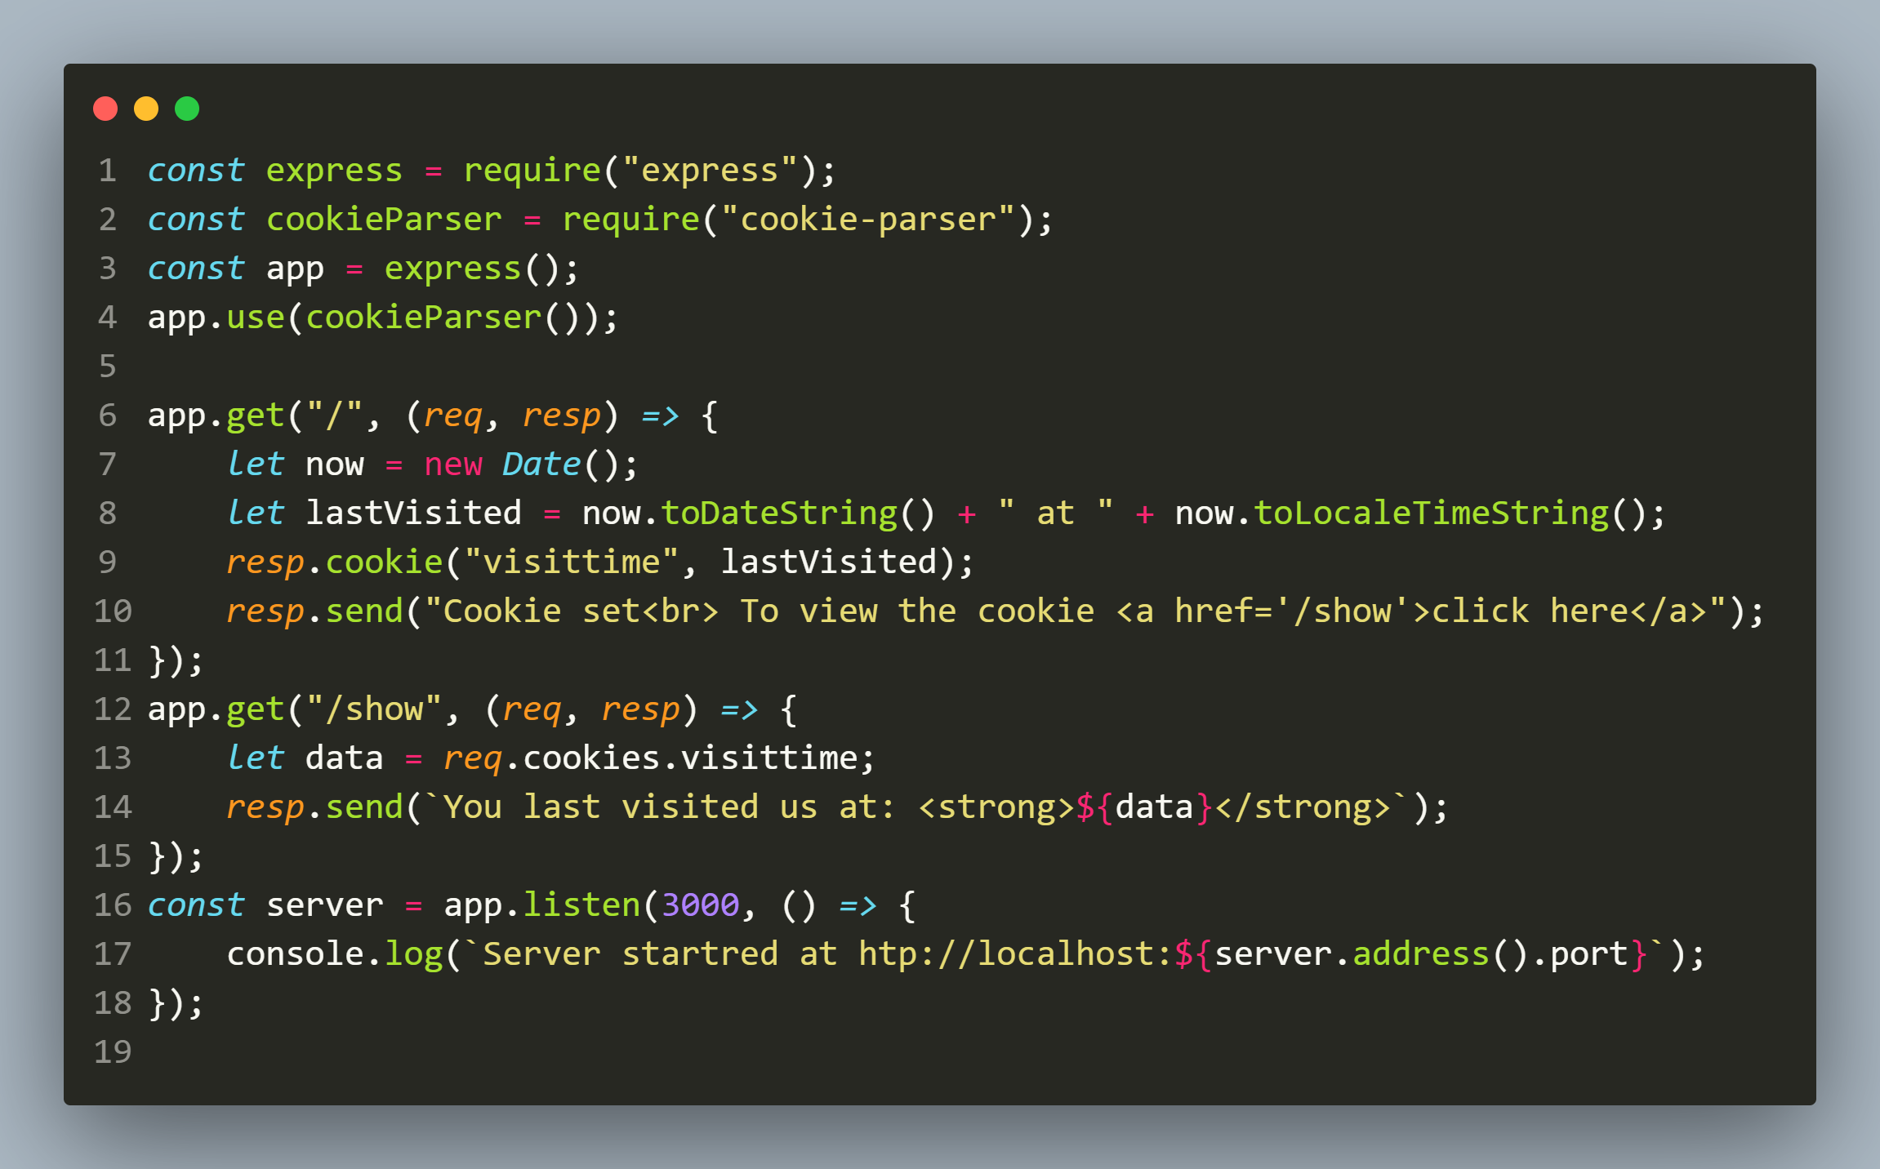
Solution

Slide 15
Setting cookie options
Cookies can also be configured with various options, such as expiration time, secure etc.
To set these options, we can pass an options object as a third argument to the res.cookie() method.

Slide 16
Setting cookie options
key | value
expires | The expiry time of the cookie in GMT format. Default value is 0, that creates a session cookie
httpOnly | Sets cookie to be only used by the web server.
maxAge | Sets the expiry time relative to the current time in milliseconds.
secure | This marks the cookie to be used only with https.

Slide 17
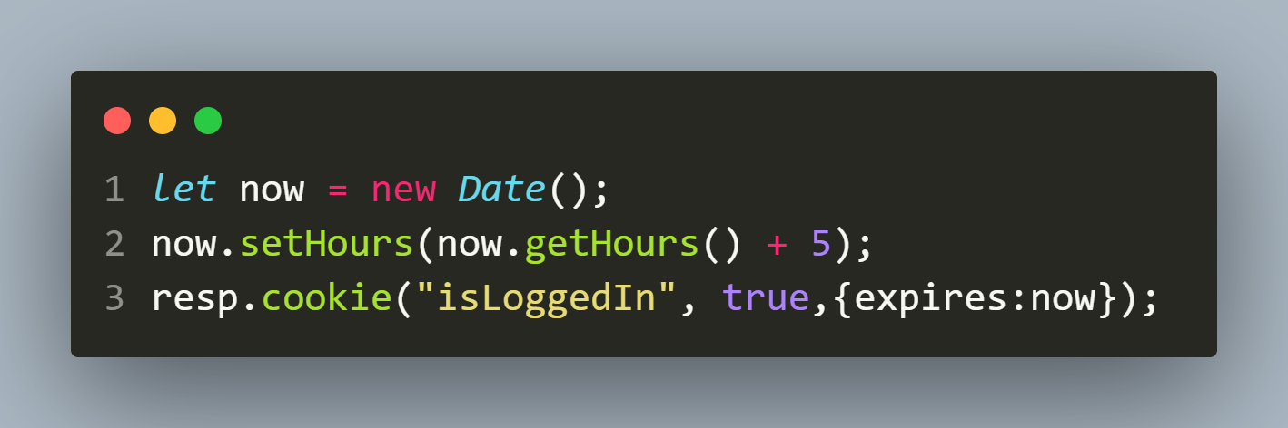
Adding cookie with expiry
To add a cookie that expires, we pass options object to res,cookie() method with property 'expires' set to the time when we want it to expire.
For example:

Slide 18
Securing cookie from hackers
It is very common that hackers steal other people's cookies to gain access to unauthorized pages.
Securing cookies is very important for any website and this can be done using 2 properties:
secure: We set it to true , so that browser will reject cookies unless the connection happens over HTTPS.
httpOnly: If set to true , then it ensures that a cookie is not accessible using the JavaScript code.

Slide 19
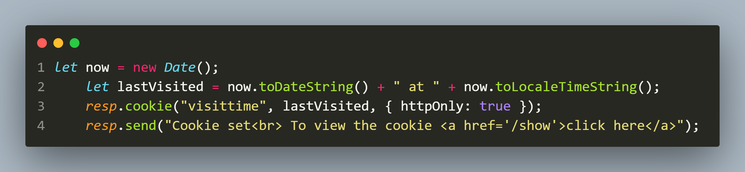
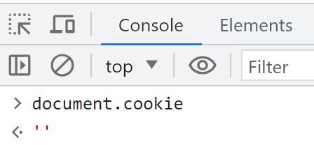
example
Trying to access the cookie in browser will show empty string

Slide 20
Deleting cookie
To clear a cookie we call the method clearCookie() using the response object.
Syntax:
resp.clearCookie(‘<cookiename>’);
Example:
resp.clearCookie(‘username’);

Slide 21
Exercise 88
Develop a Login authentication app using cookie.
Your app should behave as follows:
On home route it should check whether the user is logged in or not.
If he is not logged in then it should display the message Hello there , welcome and should provide a link to login page
If he is logged in then it should display the message Hello there , welcome followed by the username by which the user has logged in and should provide a link to logout.

Slide 22
Exercise 88
When the user clicks on login link a login page should appear which should ask the user to input his credentials.
If the credentials are valid then a page should appear welcoming the user by his username and should provide a logout link , otherwise an error message Invalid username or password should appear on login page.
When the user logsout he should be redirected to the login page

Slide 23
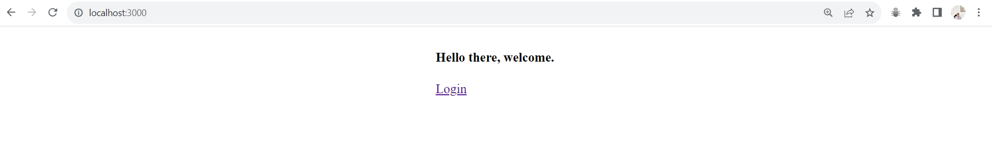
Desired output
Response of home route if user is not logged in

Slide 24
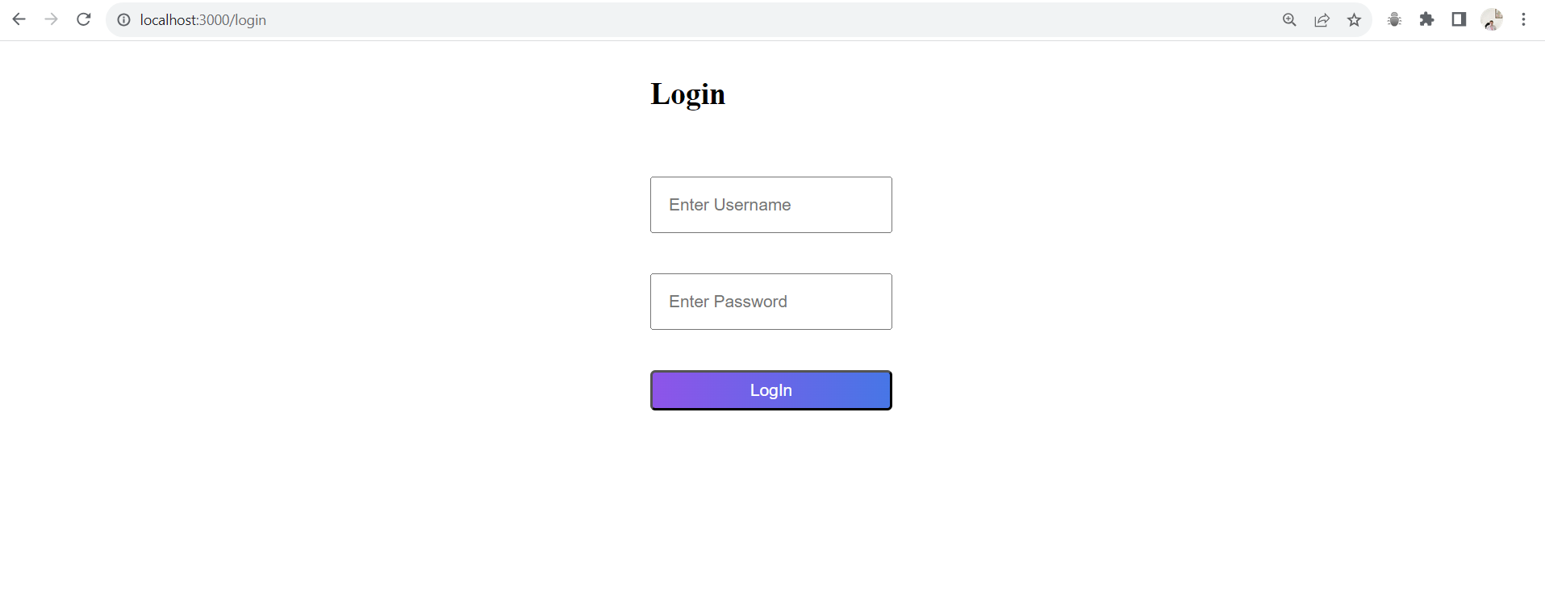
Desired output
On clicking login

Slide 25

Desired output
On wrong credentials

Slide 26
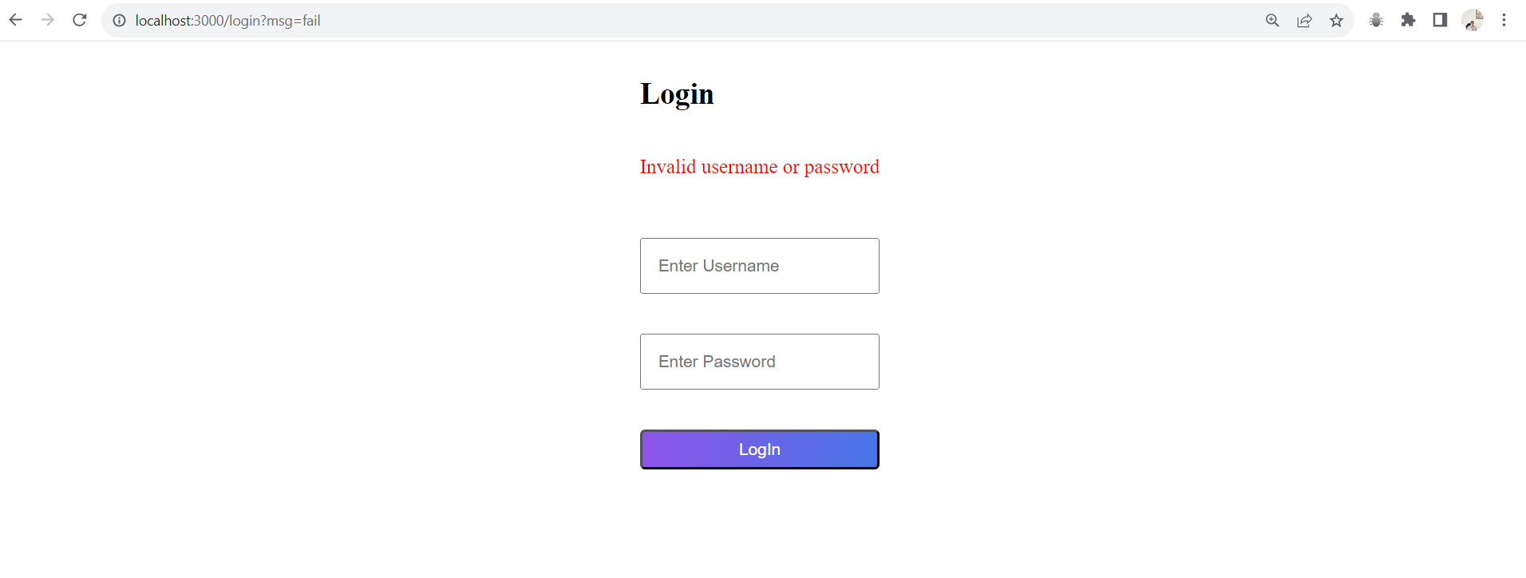
Desired output
On wrong credentials

Slide 27
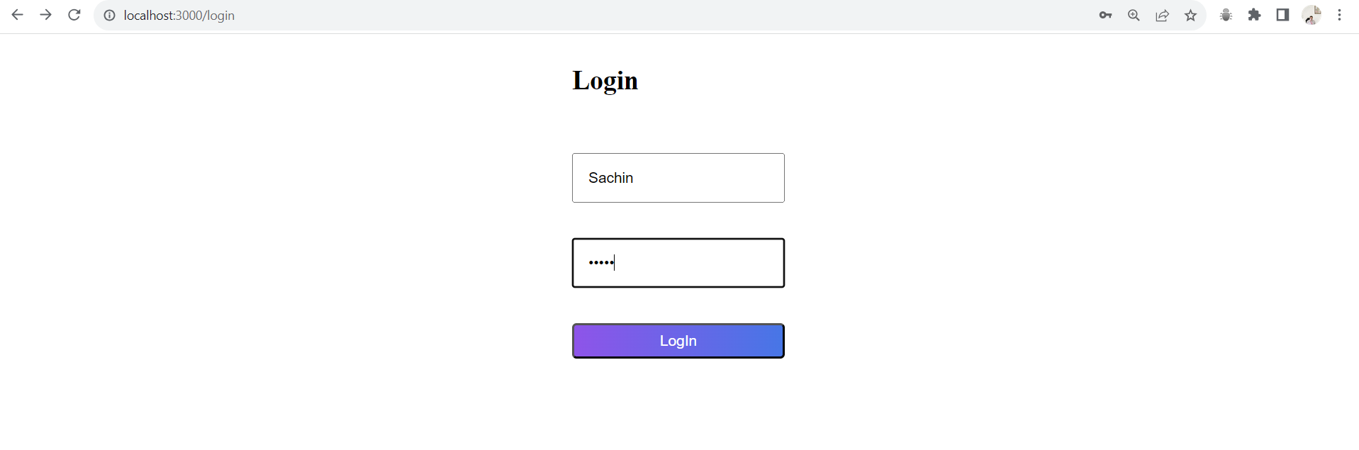
Desired output
On right credentials

Slide 28
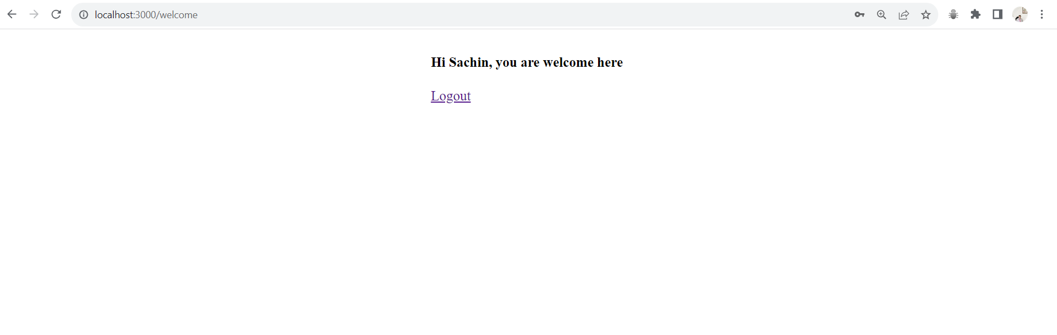
Desired output
On right credentials

Slide 29
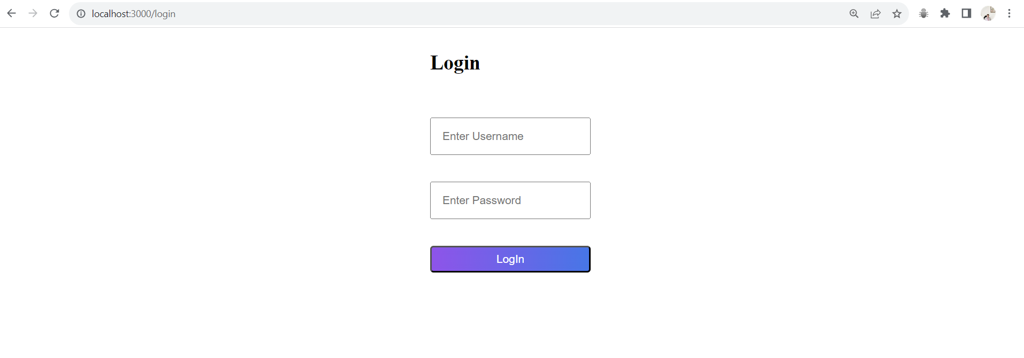
Desired output
On clicking logout

Slide 30
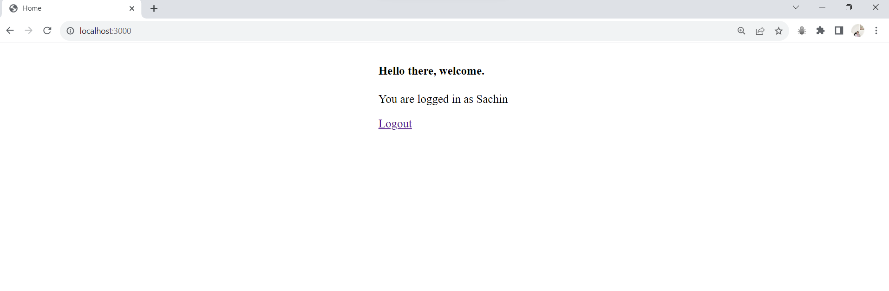
Desired output
If user is already logged in and he accesses the home route

